Slide 1
A Closer Look at Events
Notes:
In this chapter we're going to take a closer look at how events work in JavaScript. There's much more to events in JavaScript than you probably imagined!

Slide 2
Contents
Event-handling techniques
Event flow
Working with HTML events
Demos folder:
Demos\03-Events
Notes:
Section 1 describes various ways for registering event-handler functions in JavaScript, and for implementing those event handlers.
Section 2 describes how events "flow" from one element to its ancestors and/or descendants in the DOM tree. If you're familiar with WPF, it's a bit like event bubbling and event tunnelling.
Section 3 shows some examples of common types of events you'll typically need to handle in a Web page (mouse movements, button clicks, etc.).

Slide 3
1. Event-Handling Techniques
Overview
Inline event handlers
Multiple inline event handlers
Event handler functions
Using DOM and the Event object
Dynamically adding and removing handlers
Distinguishing event types
Notes:
JavaScript provides several different ways for handling events. We’ll take a look at all the options in this section.

Slide 4
Overview
HTML elements raise various events
E.g. page loaded
E.g. keyboard and mouse interactions
E.g. button clicks
The simplest way to handle events is by using an event attribute
Elements define an event attribute for each event they support
The name of the event attribute is on<eventname>
E.g. onmouseover is the event attribute for the global mouseover event
Notes:
Events play a crucial role in Web development. Much of what you do in JavaScript is in response to events, so obviously it's essential you know how to handle events properly.
The simplest way to handle an event on an element is to set its onxxx property to a chunk of JavaScript code (e.g. a function) to handle the event. We'll look at this approach on the next few slides.

Slide 5
Inline Event Handlers
As discussed earlier, you can implement an event handler inline
This example handles the mouseover event for a <p> element, via the onmouseover event attribute
Executes inline JavaScript in response to the event
<p onmouseover="this.style.background='orange'; this.style.color='blue'">
<b>Script / Text of Act I Macbeth</b>
</p>
InlineEventHandlers1.html
mouseover
event
Notes:
In this example, when you move the mouse over the <p> element, the inline JavaScript code sets the element to have a different colour scheme.
When you move the mouse away, nothing much happens. Specifically, the element does not automatically revert to its original colour scheme.
Try running this example in a browser to see the effects for yourself.

Slide 6
Multiple Inline Event Handlers
This example shows how to handle multiple events on the same element
Handles the mouseover and mouseout events for a <p> element, via onmouseover and onmouseout
Executes inline JavaScript in response to each event
<p onmouseover="this.style.background='orange'; this.style.color='blue'"
onmouseout="this.style.background='grey'; this.style.color='white'">
<b>Script / Text of Act I Macbeth</b>
</p>
InlineEventHandlers2.html
mouseover
event
mouseout
event
Notes:
This example defines inline event handlers for both the "mouse-in" and "mouse-out" events. Now, when you move the mouse away from the element, the element reverts to its original grey-and-white colour scheme.

Slide 7
Event Handler Functions
You can simplify element definitions (and reuse JavaScript) by placing event-handling logic in a separate function
Common to pass this as a parameter, to identify target element
<script type="text/javascript">
function handleMouseOver(elem) {
elem.style.background = 'orange';
elem.style.color = 'blue';
}
function handleMouseOut(elem) {
elem.style.background = 'grey';
elem.style.color = 'white';
}
</script>
<p onmouseover="handleMouseOver(this)" onmouseout="handleMouseOut(this)">
<b>Script / Text of Act I Macbeth</b>
</p>
<p onmouseover="handleMouseOver(this)" onmouseout="handleMouseOut(this)">
…
</p>
EventHandlerFunctions.html
Notes:
The previous two slides showed inline code for event handlers. In general, this approach is unrealistic because you typically have too much code to put in your event handler.
Thus in general, you define out-of-line event-handler functions to perform the event-handling tasks, and you call these event-handler functions when the relevant event fires.
Note the example in the slide has two <p> elements. Each <p> element uses the same function to handle "mouse-in" events, i.e. handleMouseOver(). For each event, we pass this as a parameter; this represents the current element, i.e. the particular <p> that the mouse is now hovering over. In this way, the handleMouseOver() function can operate on the correct <p> element.
The example also has a common event handler function for "mouse out" events on the two <p> elements, i.e. handleMouseOut().

Slide 8
Using DOM and the Event Object (1)
The simple handlers in the previous examples are fine for basic tasks…
However, for more sophisticated tasks, it's better to work with DOM and the Event object
To use DOM to hook up events, follow these steps:
Use DOM and JavaScript to locate elements
For these elements, attach event handlers for interesting events (events are designated by attributes such as onmouseover)
To implement event handler functions, follow these steps:
Define a function that takes an Event parameter
Use Event's target property to identify the target element
Use other Event properties as needed (e.g. bubbling - see later)
Notes:
A more sophisticated and powerful way to handle events is to make use of the DOM event APIs. The following slide shows an example.

Slide 9
Using DOM and the Event Object (2)
Here's an example of how to handle events by using DOM and the Event object
<p>
<b>Script / Text of Act I Macbeth</b>
</p>
<p>
…
</p>
<script type="text/javascript">
function handleMouseOver(e) {
e.target.style.background = 'orange';
e.target.style.color = 'blue';
}
function handleMouseOut(e) {
e.target.style.background = 'grey';
e.target.style.color = 'white';
}
var pElems = document.getElementsByTagName("p");
for (var i = 0; i < pElems.length; i++) {
pElems[i].onmouseover = handleMouseOver;
pElems[i].onmouseout = handleMouseOut;
}
</script>
DomAndEventObjects.html
Notes:
Note the following points in this example:
handleMouseOver and handleMouseOut are our event-handler functions. Each of these functions receives an Event object as a parameter. The Event object has various properties that give you some context about the event; for example, the target property identifies the target element (e.g. a <p> element) for which the event applies.
To register handleMouseOver and handleMouseOut as event-handler functions, you can assign the function names to the onmouseover and onmouseout properties in each <p> element.

Slide 10
Dynamically Adding/Removing Handlers
Use addEventListener()/removeEventListener()
<button id="toggle">Toggle events</button>
<script type="text/javascript">
function toggleEvents() {
eventsEnabled = !eventsEnabled;
if (eventsEnabled) {
for (var i = 0; i < pElems.length; i++) {
pElems[i].addEventListener("mouseover", handleMouseOver);
pElems[i].addEventListener("mouseout", handleMouseOut);
}
}
else {
for (var i = 0; i < pElems.length; i++) {
pElems[i].removeEventListener("mouseover", handleMouseOver);
pElems[i].removeEventListener("mouseout", handleMouseOut);
}
}
}
…
var pElems = document.getElementsByTagName("p");
var buttonElem = document.getElementById("toggle");
buttonElem.onclick = toggleEvents;
var eventsEnabled = false;
…
AddRemoveEventListeners.html
Notes:
A variation of the previous slide is to call addEventListener on an object, to add an event handler for a specified event name. The examples in the slide show a simple version of addEventListener where you pass in two parameters:
The name of the event as a string (note this is something like "mouseover", not "onmouseover").
The event-handler function (without parentheses).
There's also a converse function removeEventListener named , which allows you to remove an event-handler function for an event on an object.

Slide 11
Distinguishing Event Types
The Event object has a type property
Identifies the event type (e.g. "mouseover", "mouseout", etc.)
Allows you to define a common event-handler function that handles multiple types of events
<script type="text/javascript">
function handleMouseEvent(e) {
if (e.type == "mouseover") {
e.target.style.background = 'orange';
e.target.style.color = 'blue';
}
else if (e.type == "mouseout") {
e.target.style.background = 'grey';
e.target.style.color = 'white';
}
}
var pElems = document.getElementsByTagName("p");
for (var i = 0; i < pElems.length; i++) {
pElems[i].onmouseover = handleMouseEvent;
pElems[i].onmouseout = handleMouseEvent;
}
</script>
EventTypes.html
Notes:
As we explained a few slides earlier, when you implement an event-handler function, the function receives an Event object as a parameter. The Event object has various interesting and useful properties, including type (which indicates the type of event being handled).
The example in the slide shows how to use the type property to differentiate between "mouseover" and "mouseout" events in a common event-handler function.

Slide 12
2. Event Flow
Overview of event flow
Understanding the capture phase
Handling descendant events
Identifying the target of an event
Stopping propagation
Notes:
This section explores one of the less-well known areas of JavaScript events, whereby an event can pass through multiple elements on its journey. The idea is that each element has its own chance to handle the event if it wants to.
It might sound arcane, but its actually very useful to know!

Slide 13
Overview of Event Flow
An event has a lifecycle that comprises 3 phases:
Capture
Target
Bubbling
The Event object has an eventPhase property that identifies the current phase
function anEventHandlerFunction(e) {
if (e.eventPhase == Event.CAPTURING_PHASE) {
…
}
else if (e.eventPhase == Event.AT_TARGET) {
…
}
else { // e.eventPhase == Event.BUBBLING_PHASE
…
}
}
Notes:
JavaScript events exist in three distinct phases:
The "capture" phase occurs first. The user has just done something (e.g. moved the mouse over an element). The event is first passed to the ultimate ancestor of the element in the DOM tree, to see if this ancestor element wants to have a "first go" at handling the event. The event is then passed to each other ancestor in the DOM tree, working its way down the tree, getting closer and closer to the actual element upon which the event was originally triggered.
The "target" phase occurs next. The event is delivered to the actual target element, to see if it wants to handle it.
Finally, the "bubbling" phase occurs. This is the opposite of the capture phase. In the bubbling phase, the event is passed back up the DOM tree. First the element's parent gets the event, then it's parent's parent, and so on.
You can write an event-handler function to handle an event during any (or all) of these phases. The Event parameter has an eventPhase property which indicates the current phase of the event. The example in the slide shows how this works.
The following slides explain why you might want to handle events in the capture phase or in the bubbling phase.

Slide 14
Understanding the Capture Phase
When an event is triggered, the browser identifies the element the event relates to
This is known as the event target
The browser identifies all of the ancestor elements, from <body> down to the target element
... to see if any ancestors have registered an interest in handling events generated by their descendants
The browser triggers any such handlers before triggering the handler on the target itself
Thus, ancestor elements get a chance to handle the event before it's seen by the real target
This is similar to "preview events" in WPF ☺
Notes:
The capture phase allows ancestors of an element to get a sneak preview of the event first, before it is delivered to the actual target element. This is typically used as a way of filtering out unwanted events, so the target element is unaware anything happened.

Slide 15
Handling Descendant Events
For an element to handling events generated by its descendent elements:
On the high-level element, call addEventListener()
For parameter 1, specify the name of the event
For parameter 2, specify the high-level event-handler function
For parameter 3, pass true
Tells the browser that the high-level element wants to receive events for its descendants during the capture phase
aHighLevelElement.addEventListener("anEventName", highLevelEventHandler, true);
Notes:
To handle an event in the capture phase, call addEventListener() on an ancestor element, and pass true as the third parameter to the function. The true parameter tells the event mechanism that the event-handler function should capture this event for all of the element's descendants.

Slide 16
Identifying the Target of an Event
The Event object has two properties that help you to identify the target of the event:
target
currentTarget
Notes:
Within an event-handler function, the Event parameter has two properties that relate to the elements involved:
target This is the real target of the event, e.g. a low-level <span> that you mouse-over.
currentTarget This is the current ancestor element, which has intercepted the event on its downward journey through the DOM tree during the capture phase. For example, a parent <div> that contains the <span>.

Slide 17
Stopping Propagation
The Event object has two functions that allow an event handler to stop flow of an event on its journey:
stopPropagation()
stopImmediatePropagation()
Notes:
The Event object has a pair of functions that allow an event-handler function to stop the event from going any further in its journey:
stopPropagation() This function ensures that all of the event listeners registered for the current element will be invoked, but it stops the event from going any further down the element tree. It also prevents the "target" and "bubbling" phases (see later).
stopImmediatePropagation() This function causes any un-triggered event-handler functions to be skipped. It also stops event from going any further, as per stopPropagation().

Slide 18
Understanding the Target Phase
The "target" phase is the simplest of the 3 phases in the lifecycle of an event
When the "capture" phase has finished …
The browser triggers any event-handler functions registered on the target element itself
If stopPropagation() / stopImmediatePropagation() is invoked during the "target" phase:
The browser will stop the flow of the event
The "bubble" phase won’t be performed
Notes:
To handle an event in the target phase, call addEventListener() on the actual element itself, and don't pass anything for the third parameter to the function. This indicates the event-handler function will handle the event for that particular element only, and not on any of the element's descendants.

Slide 19
Understanding the Bubble Phase
The "bubble" phase is the last of the 3 phases in the lifecycle of an event
When the "target" phase has finished …
The browser starts working its way back up the chain of ancestor elements, towards the <body> element
The browser looks for any event-handler functions that are not "capture-enabled"
i.e. where the 3rd argument to addEventListener() is false
This is known as "event bubbling"
Note:
Not all events support bubbling
The Event object has a bubbles property (true or false)
Notes:
To handle an event in the bubble phase, call addEventListener() on an ancestor element, and pass false as the third parameter to the function. The false parameter tells the event mechanism that the event-handler function should handle the event as it bubbles outwards from the element's descendants.

Slide 20
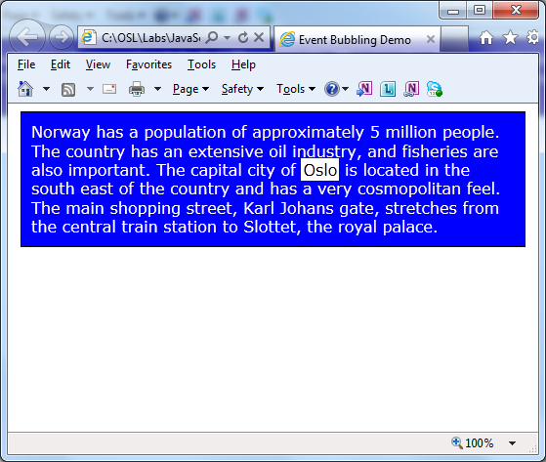
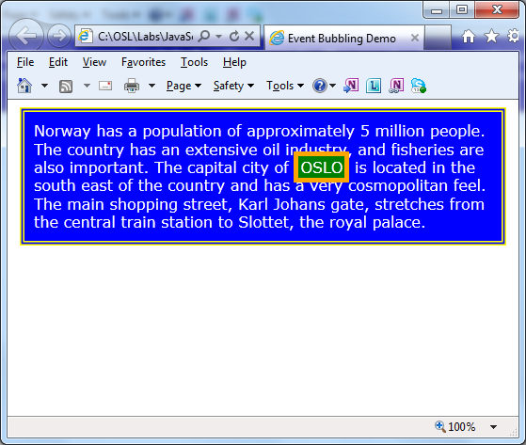
Complete Example
For a complete example of everything we've discussed in this section:
See EventFlow.html
Notes:
The EventFlow.html demo gives a comprehensive example of event flow. Open the Web page in a browser to see how it works, then take a look at the JavaScript code to see how it's implemented internally.

Slide 21
Working with Cancelable Events
Some events have a default action
E.g. <a> elements have a click event, whose default action is to tell the browser to load the content at the specified href
For events that have a default action:
The Event object has a cancelable property set to true
We can prevent the default action by calling preventDefault()
Example:
See CancelingEvents.html
function handleClickForHyperlink(e) {
if (!confirm("Do you want to navigate to " + e.target.href + " ?")) {
e.preventDefault();
}
}
Notes:
The Event object has a preventDefault() method that allows an event-handler function to suppress the default behaviour for an event. The example in the slide shows how to give the user an opportunity to cancel a hyperlink from causing a navigation away from the current Web page.

Slide 22
3. Working with HTML Events
Mouse events
Focus events
Keyboard events
Notes:
HTML defines a set of events grouped by type:
Mouse events
Focus events
Keyboard events
The best way to understand these events is by looking at sample code. See the following slides ☺.

Slide 23
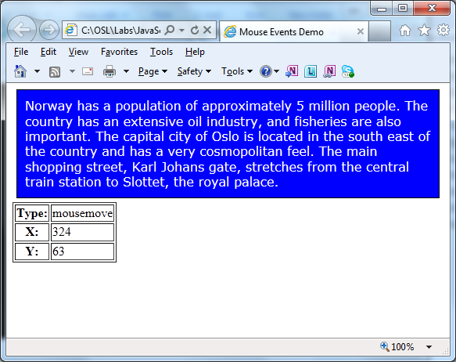
Mouse Events
For an example of mouse events:
See MouseEvents.html
Notes:
MouseEvents.html illustrates how to handle various mouse-related events. As you can see, mouse events indicate the co-ordinates where the mouse event occurred, which is usually important to know!

Slide 24
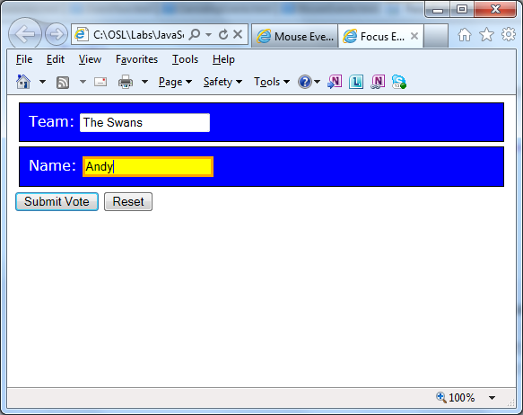
Focus Events
For an example of focus events:
See FocusEvents.html
Notes:
FocusEvents.html illustrates how to handle events indicating that an element has gained or lost input focus.

Slide 25
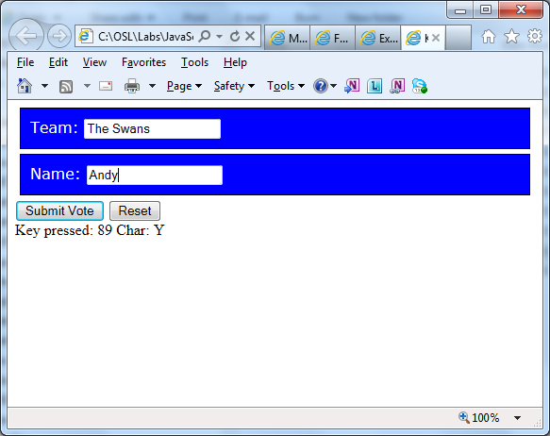
Keyboard Events
For an example of keyboard events:
See KeyboardEvents.html
Notes:
KeyboardEvents.html illustrates how to handle keyboard events, so you can have fine-tuned control over every keystroke from the user.

Slide 26
Any Questions?

